Slide 1
Chapter 10
Routing Protocols

Slide 2
Objectives
Identify common IPv4 and IPv6 routing protocols
Explain the purpose and properties of routing

Slide 3
Routing Protocol Basics
There are two types of routing protocols used in internetworks: interior gateway protocols (IGPs) and exterior gateway protocols (EGPs).
  IGPs are used to exchange routing information with routers in the same autonomous system (AS). An AS is a collection of networks under a common administrative domain, which simply means that all routers sharing the same routing table information are in the same AS.
  EGPs are used to communicate between multiple ASs.

Slide 4
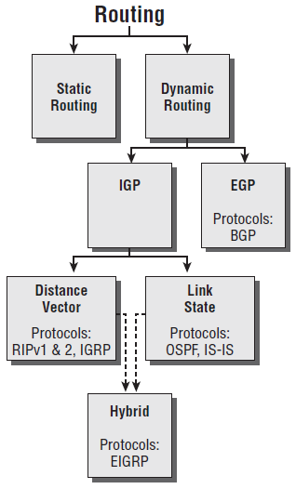
Routing Protocol Basics (contd…)
Routing flow tree

Slide 5
Administrative Distances
The administrative distance (AD) is used to rate the trustworthiness of routing information received on one router from its neighboring router. An AD is an integer from 0 to 255, where 0 equals the most trusted route and 255 the least. A value of 255 essentially means, “No traffic is allowed to be passed via this route.”

Slide 6
Administrative Distances (contd…)
Default Administrative Distances
Route Source | Default AD
Connected interface | 0
Static route | 1
EIGRP | 90
IGRP | 100
OSPF | 110
RIP | 120
External EIGRP | 170
Unknown | 255 (this route will never be used)

Slide 7
Classes of Routing Protocols
Distance vector The distance-vector protocols find the best path to a remote network by judging—you guessed it—distance. Each time a packet goes through a router, it equals something we call a hop. The route with fewest hops to the network is determined to be the best route.
Link state Using link-state protocols, also called shortest-path-first protocols, the routers each create three separate tables. One of these tables keeps track of directly attached neighbors,
one determines the topology of the entire internetwork, and one is used as the actual routing table.
Hybrid Hybrid protocol uses aspects of both distance vector and link state, and at this writing, there’s only one—EIGRP. It happens to be a Cisco proprietary protocol, meaning that it will only run on Cisco equipment.

Slide 8
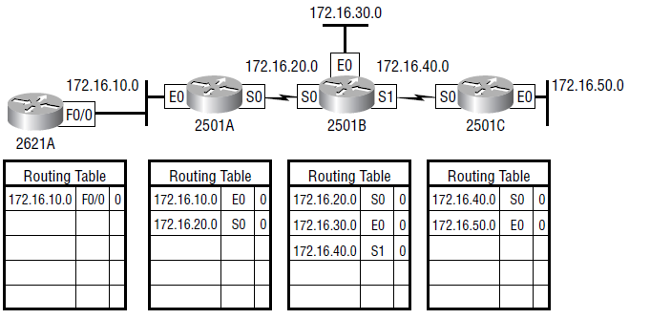
Distance-Vector Routing Protocols
Distance vector uses only hop count to determine the best path to a network. If a router finds more than one link with the same hop count to the same remote network, it will automatically perform what’s known as round-robin load balancing.

Slide 9
Routing Information Protocol (RIP)
RIP is a true distance-vector routing protocol. It sends the complete routing table out to all active interfaces every 30 seconds. RIP uses only one thing to determine the best way to a remote network—the hop count. And because it has a maximum allowable hop count of 15 by default, a hop count of 16 would be deemed unreachable.
  RIP version 1 uses only classful routing, which means that all devices in the network must use the same subnet mask. RIP version 2 provides something called prefix routing and does send subnet mask information with the route updates. Doing this is called classless routing.

Slide 10
RIP Version 2 (RIPv2)
Both RIPv1 and RIPv2 are distance-vector protocols, which means that each router running RIP sends its complete routing tables out all active interfaces at periodic time intervals. Also, the timers and loop-avoidance schemes are the same in both RIP versions (that is, holddown timers and split horizon rule). Both RIPv1 and RIPv2 are configured as classful addressing (but RIPv2 is considered classless because subnet information is sent with each route update), and both have the same AD (120).

Slide 11
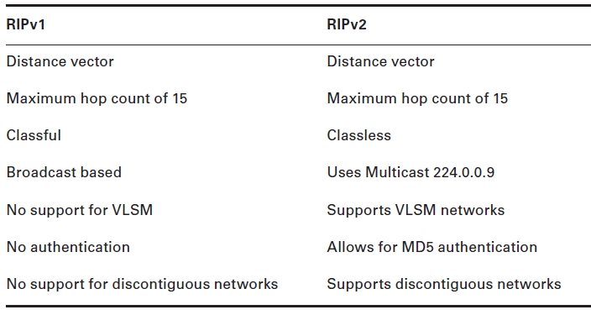
RIP Version 2 (RIPv2) (contd…)
The differences between RIPv1 and RIPv2:

Slide 12
EIGRP
EIGRP is a classless, enhanced distance-vector protocol that gives us a real edge over another Cisco proprietary protocol, IGRP.
EIGRP uses the concept of an autonomous system to describe the set of contiguous routers that run the same routing protocol and share routing information. But unlike IGRP, EIGRP includes the subnet mask in its route updates.
EIGRP is referred to as a hybrid routing protocol because it has characteristics of both distance-vector and link-state protocols.

Slide 13
EIGRP (contd…)
There are a number of powerful features that make EIGRP a real standout from RIP, RIPv2, and other protocols.
  Support for IP and IPv6 (and some other useless routed protocols) via protocol-dependent modules
  Considered classless (same as RIPv2 and OSPF)
  Support for VLSM / Classless Inter-NN Domain Routing (CIDR)
  Support for summaries and discontiguous networks
  Efficient neighbor discovery
  Communication via Reliable Transport Protocol (RTP)
  Best path selection via Diffusing Update Algorithm (DUAL)

Slide 14
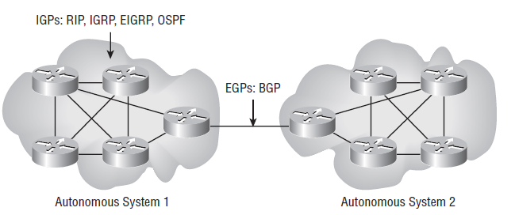
Border Gateway Protocol (BGP)
BGP is essentially an alternative to using default routes for controlling path selections. Because the Internet’s growth rate shows no signs of slowing, ISPs use BGP for its ability to make classless routing and summarization possible. These capabilities help to keep routing tables smaller and more efficient at the ISP core. BGP is used for IGPs to communicate ASs together.

Slide 15
Link-State Routing Protocols
Link-state protocols also fall into the classless category of routing protocols, and they work within packet-switched networks. Examples of link-state routing protocols include OSPF and IS-IS.
One of the biggest differences between link-state and distance-vector protocols is that link-state protocols learn and maintain much more information about the internetwork than distance-vector routing protocols do. Distance-vector routing protocols only maintain a routing table with the destination routes in it.

Slide 16
Open Shortest Path First (OSPF)
Open Shortest Path First (OSPF) is an open standard routing protocol that’s been implemented by a wide variety of network vendors, including Cisco. OSPF works by using the Dijkstra algorithm.
  OSPF provides the following features:
  Consists of areas a NN nd autonomous systems
  Minimizes routing update traffic
  Allows scalability
  Supports VLSM/CIDR
  Has unlimited hop count
  Allows multi-vendor deployment (open standard)

Slide 17
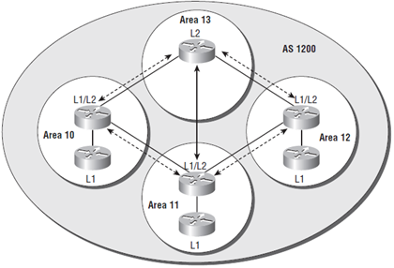
Intermediate System to Intermediate System (IS-IS)
IS-IS is a link-state routing protocol, meaning that it operates by reliably flooding topology information throughout a network of routers. Each router then independently builds a picture of the network’s topology, just like OSPF does. Packets or datagrams are forwarded based on the best topological path through the network to the destination.

Slide 18
IPv6 Routing Protocols
Knowing that broadcasts have been eliminated in IPv6, it follows that any protocols that use entirely broadcast traffic will go the way of the dodo—but unlike the dodo, it’ll be good to say goodbye to these bandwidth hogging, performance-annihilating little gremlins!

Slide 19
IPv6 Routing Protocols- RIPng
It is still a distance-vector protocol, has a max hop count of 15, and uses split horizon, poison reverse, and other loop avoidance mechanisms, but it now uses UDP port 521.
The difference is that with RIPng, the router keeps track of this next-hop address using the link-local address, not a global address.

Slide 20
IPv6 Routing Protocols- EIGRPv6
EIGRPv6 is still an advanced distance-vector protocol that has some link-state features. The neighbor-discovery process using hellos still happens, and it still provides reliable communication with a reliable transport protocol that gives us loop-free fast convergence using DUAL.
Hello packets and updates are sent using multicast transmission; and as with RIPng, EIGRPv6’s multicast address stayed almost the same. In IPv4 it was 224.0.0.10; in IPv6, it’s FF02::A (A = 10 in hexadecimal notation).

Slide 21
IPv6 Routing Protocols- OSPFv3
it is still a link-state routing protocol that divides an entire internetwork or autonomous system into areas, making a hierarchy.
Adjacencies (neighbor routers running OSPF) and next-hop attributes now use link-local addresses, and OSPFv3 still uses multicast traffic to send its updates and acknowledgements, with the addresses FF02::5 for OSPF routers and FF02::6 for OSPF-designated routers. These new addresses are the replacements for 224.0.0.5 and 224.0.0.6, respectively, which were used in OSPFv2.

